Slide 1

Understanding Current Immigration Issues
March 1, 2018

Slide 2
Presenters
Heather Yountz
  Associate at Demissie & Church in Cambridge
  Represents a wide variety of immigration clients
  On the Massachusetts team to defeat the “first Muslim ban” (see http://www.bostonglobe.com/metro/2017/01/29/narrative/zU2X61MVP8J4IvGP8zu1hM/story.html)
Michael Diener
  Volunteer at the Irish International Immigrant Center (IIIC), Political Asylum/Immigration Representation (PAIR) Project, and Community Legal Services and Counseling Center (“Classic”)

Slide 3
Goals
General understanding of the composition of people in the US
Understanding basic terms that are in the news
Perspectives on numbers of people and policy tradeoffs
International perspectives
NOTES: This is a general overview. It covers typical situations, and might not include nuances and exceptions. Also, policies, rules, and interpretations can change over time. Immigration is complicated!
If you have a personal issue, get legal advice.

Slide 4
“Nation of Immigrants”
1920s law set country quotas, tied to 1890 census to exclude Italians, Jews, Poles, etc.
1960s law emphasized family re-unification
Current share of population is comparable to the decades before WW I

Slide 5
Nations of Immigrants
US % is not that unusual for “Western-style” democracies
France 11.1
Netherlands 11.1
Belgium 12.9
United Kingdom 13.2
Norway 13.8
Spain 14.0
United States 14.3
Sweden 14.3
Germany 14.9
Ireland 15.9
Canada 21.9
New Zealand 25.1
Israel 26.5
Australia 27.7
Some lowest level countries
China, Indonesia, Vietnam, Cuba 0.1
Eritrea, Iraq, Afghanistan <0.5
UN Report 2015

Slide 6
327m+ people living in the United States
US Citizens (about 300m; 90+%)
“Aliens” (“any person not a citizen or national of the United States”)
  Legal Permanent Residents (LPRs) (14-15m) (4-5%)
  Lawfully here with a status that can be “adjusted” to LPR status (maybe 1m)
    Examples: Refugees, asylees, U-visa for victims of crime, H1-B employees
  People we could make leave, but do not (or who would be out of status); e.g.
    Asylum applicants with pending applications (over 100,000)
    TPS (several 100,000s)
    Deferred action or humanitarian parole
  Undocumented (12m) (4%) (about 3% in MA)
Does not include tourists (B visa), foreign students (F visa), cultural exchange (J visa), and other people who do not intend to stay permanently
NOTE: alien is a simple legally defined term; “immigrant” and “non-immigrant” are much more complicated

Slide 7
How to become a citizen
At birth
After birth
  Naturalization
  Derive from a new citizen parent

Slide 8
Citizenship at birth
“Birthright citizenship” (or “jus soli”, law of the soil)
  “All persons born or naturalized in the United States, and subject to the jurisdiction thereof, are citizens of the United States and of the state wherein they reside.” (14th Amendment)
  Applies even to children of undocumented people, or visitors
Birthright citizenship is the norm in the Americas, but rare in the rest of the world; some countries outside the Americas have cut it back
  Opposition: some argue 14th Amendment is not so broad, but this is a small minority view; others propose amending the Constitution to change this
OR, born abroad child of US citizen parent(s) (with some exceptions)

Slide 9
“Birth Tourism”
When a women comes to the US so her child will be a US citizen
  Estimates vary widely, but potentially in the 10,000s per year
  Potential to sponsor a parent after age 21
    Source of pejorative term “anchor baby”
Downside for birthright citizens who do not live here: US requires payment of income tax for all citizens regardless of where they reside, or parental citizenship, or if they have multiple citizenships
  Very unusual requirement
  Need to formally renounce citizenship to avoid taxation

Slide 10
“natural born Citizen” and “birtherism”
“No Person except a natural born Citizen, or a Citizen of the United States, at the time of the Adoption of this Constitution, shall be eligible to the Office of President” (Constitution, Article II)
Most believe it means citizen at birth, not naturalized
  Either US citizen parent, or born in the US
Ted Cruz: citizen father, born in Canada
John McCain: citizen parents, born in Panama Canal Zone
Marco Rubio: no citizen parents, born in US
Barack Obama: citizen mother, born in Hawaii
  Even if born in Kenya, it would not matter! (same as Ted Cruz)

Slide 11
How to become a citizen: Naturalization
Can apply for citizenship after 5 years of being an LPR; 1 yr to process
  Or 3 years if married the whole time to a USC
  Some quirks for asylees/refugees, but still at least 5 years of US residence
Show proficiency in English
  Some exceptions based on age and length of residence
Pass a citizenship test
  2012 study: 1/3 of native-born citizens failed
Not have committed certain crimes or done certain acts
    Some “bad acts” can be waived under the law by making a filing; some cannot
    Some acts are not deportable, but do not allow citizenship
Typical minimum time from green card → citizenship = 6 years
  But many do not apply until years after they are eligible
Derivation: Minor children of naturalized citizens can automatically become citizens when parent naturalizes, but there are limitations

Slide 12
New Naturalizations Annually
In a range of about 600,000-800,000 since 2009
  About 716,000 average since 2009
    Comparable to population of Alaska or DC
  0.22% of the total citizen population
73% of new naturalized citizens in 2016 were from 10 states:
  California, New York, Florida, Texas, New Jersey, Illinois, Massachusetts (7th), Washington, Virginia, and Maryland
Countries of origin in order in 2016:
  Mexico, India, Philippines, China, and Cuba.
About 70,000 denied per year for the last several years
  Could fail language assessment, fail citizenship test, or “bad acts”

Slide 13
What is LPR status (Green Card holder)?
Legal Permanent Resident
Permanent right to live and work in the US
  Unless you lose LPR status
Similar rights to a US citizen except:
  No right to vote
  Can be excluded from sensitive jobs, e.g., for a military contractor
  Can be revoked if you spend too much time outside the US without permission
  Can be deported, e.g., for certain crimes

Slide 14
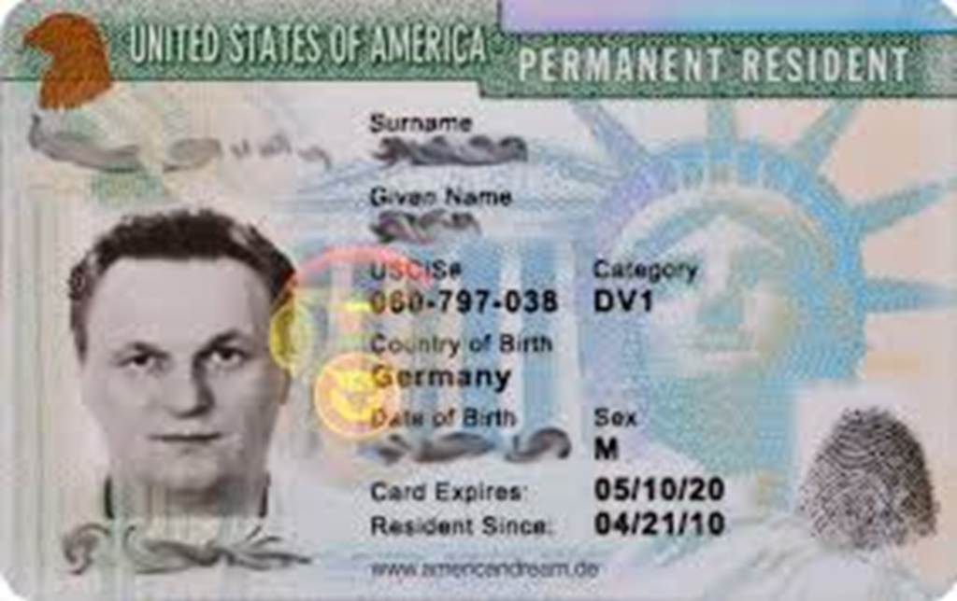
Green Card (only a little green)
Has name, birth date, category for how you got LPR status, “resident since” date, USCIS# (aka A #); the card can expire, but not the status
Also functions as proof of employment authorization

Slide 15
Processes to Get a Green Card
Consular processing; new arrivals
  Processing completed outside the US
  Get green card when you arrive
“Adjustment” to LPR from some other status
  Can adjust status in the US from certain types of legal status to LPR status

Slide 16
Getting a Green Card: Consular Processing
People who are outside the US and applying, or being sponsored
  Or required to leave the US before applying
US embassy in immigrant’s home country does the vetting
Immigrant gets the green card when arriving in the US
Resident Since date is the day of arrival
Typical types of people who use consular processing:
    Family member who live outside the US, but are sponsored by US citizens or LPRs
    Winners of the diversity visa lottery

Slide 17
Getting a Green Card: Adjustment
Used mostly by people who are in the US
File a form to “adjust” to LPR status from some other status
Types of people who typically adjust include:
  Sponsored relatives who are already in the US
  Sponsored employees
  Asylees/refugees after 1 year of asylee/refugee status in the US
  U-visa holders (victims of certain crimes), after 3 years
  Cubans, after 1 year
NO ADJUSTMENT from visitor status (B1/B2), student (F), cultural exchange (J), etc. – these statuses require you to have no intent to stay permanently in the United States

Slide 18
How many LPRs are there?
Current Aggregate: estimate of 14-15m
About 1.0 - 1.2m new LPRs annually since 2005
  About the numbers in Rhode Island; 0.3-0.4% of US pop
More new LPRs annually than new citizens, so aggregate grows

Slide 19
Where are new LPRs from (2016)?
Compare non-US pop: Asia (60%) Africa (17%) C/S Am (7%) Europe (10%); N Am (6%)
Americas overrepresented
Europe comparable
Asia/Africa underrepresented

Slide 20
Other Stats about LPRs in 2016
More female, a bit younger, and many more married
54-46% female to male
  US as a whole is about 51-49
Ages
  22% under 20 years old
  21% in their 20s
  22% in their 30s
  15% in their 40s
So, median age is about 35
Compare: US median age = 37; white non-Hispanic = 43; Hispanic = 28
58% married versus 37% in US overall

Slide 21
Paths for people to become LPRs? (2016)
1,183,000 total in 2016
Main categories:
  805,000 family sponsored in different categories (68%)
  158,000 refugees and asylee adjustments (13%)
  50,000 via diversity visa lottery (4%)
  138,000 employment/”merit”(?) (12%)
  32,000 other (3%)
Each of these categories is in the news!

Slide 22
How people become new LPRs
Main categories:
  805,000 family sponsored in different categories
  50,000 via diversity visa lottery
  158,000 refugees and asylee adjustments
  138,000 employment/ ”merit”?
Each of these categories is in the news!

Slide 23
Categories of Family Sponsorship – recent #s
Family sponsorship – about 805,000 new LPRs, over 2/3 of total
Relatives of USCs (85%); relatives of LPRs (15%)

Slide 24
Categories of Family Sponsorship – 2016
About ½ are spouses and minor children -- least controversial
Parents, adult children, and siblings (highlighted) -- more controversial
Longer wait times for some categories from China, India, Mexico, Philippines

Slide 25
Family Sponsorship of a Foreign Relative
File form; pay fee; wait for approval
  USCIS can ask for more evidence or request a DNA test
Get a visa when available
  No wait for spouses, parents, minor children of USCs
  Can be very long wait for others -- over 20 years for Filipino sibling
Pay more fees and file an application for the visa
  Sponsor files Affidavit of Support showing resources to support immigrant
  Local embassy conducts interview and background check
  Medical exams and immunizations
If all goes well … immigrant arrives and gets a green card when he/she enters the US

Slide 26
Family Sponsorship of a US-based Relative
Similar process – fill out form, pay fee, get medical exam, and file Affidavit of Support
Relative does not get any status just because someone petitioned for them
  Still need some legal basis to be in the US
  E.g., parents come to visit, and you petition for them; if parents do not leave within the 6 month visitor period (or petition for extension), it can be a problem
If all goes well, immigrant gets a green card
  Status effective when it is processed

Slide 27
In the News: “Chain Migration”
A term used by anti-immigration people to sound negative
  Typical term for family sponsorship is family reunification
Trump at 2018 SOTU: "A single immigrant can bring in unlimited numbers of distant relatives.“
Statement gives impression that your recent foreign neighbor, maybe even undocumented?, might sponsor his or her whole clan

Slide 28
In the News: “Chain Migration”
Is it true that "A single immigrant can bring in unlimited numbers of distant relatives.“
PolitiFact: Mostly False
Highly misleading at best
  Most categories require you to be a US citizen, not just any immigrant
    85% are relatives of citizens – mostly spouses, parents, and minor children
    LPRs limited to only spouse, child, and single adult children
    People who are not USCs and not LPRs cannot sponsor relatives
  Republican proposals would eliminate adult children and parents – not distant!

Slide 29
A “chain” for a first cousin: reality
True: one could build a “chain” to bring more distant relatives over time
“You” as a new LPR immigrant want to petition for a cousin
  No direct pathway – circuitous route
  You become a citizen: 5 years to file; one year wait = 6 years
  You petitions for a parent: 1 year (total = 7 years)
  Your parent becomes a citizen: 5+1 = 6 (total = 13 years)
  Your parent petitions for your aunt/uncle: 15 years+ (total = 28 years)
  Aunt/uncle sponsors child(ren): 3-20 years, dep. on age and marital status
Minimum of 31 years, and up to 48 years (for an adult married cousin)
  For many, that’s not even “distant”
For a second cousin, 57 years minimum!

Slide 30
Perspectives: “Chain Migration”
Only a US citizen can sponsor a parent, sibling, or married son/daughter (not any immigrant)
  85% of sponsored people are relatives of USCs
This is a benefit for US citizens to be able to bring family members
  Unless you consider new citizens to be less in some way
Fair point: allowing sponsorship of parents, adult children, and siblings is not typical in foreign countries
  Abolishing a category is not necessarily hostile to recent citizens, or anti-immigration – one would need to see the whole package

Slide 31
Perspectives: “Chain Migration”
Eliminating categories would eventually reduce immigration
  But if people in the pipeline remain on the list, it will take a while to see some of the effects:
  Effect on parents is immediate, because there is no wait time
  Effect on other categories depends on the wait time, and would not be felt for many years at current rates
    In this case, we would still admit 65,000 siblings per year for 15 years
    Some have suggested accelerating the wait times
RAISE Act: Republican proposals would eliminate family categories and not reallocate visas – purely about reducing numbers of legal immigrants by eliminating family categories (and other changes)

Slide 32
How people become new LPRs
Main categories:
  805,000 family sponsored in different categories
  50,000 via diversity visa lottery
  158,000 refugees and asylee adjustments
  138,000 employment/ ”merit”?
Each of these categories is in the news!

Slide 33
Diversity Visa Lottery
Concept: diversify immigrant pool
Created in 1990 – bipartisan compromise
  50,000 immigrant visas provided
  About 20m apply annually
    0.25% chance of winning (1 in 400 chance)
  Countries that have sent at least 50,000 people to the United States in the past five years do not participate
    E.g., excludes Brazil, Canada, China, India, and Mexico
Similar process to consular process for family member
  Except person in foreign country applies for him/herself
  Background checks, medical exam, and minimum education or work experience requirements

Slide 34
In the News: Diversity Visa Lottery
October 31, 2017 bike path attack in NYC
  Man drove a van down a bike path
  8 fatalities; 5 from Argentina
Suspect entered the U.S. in 2010 from Uzbekistan under the Diversity Visa Lottery
  Although reports were that he self-radicalized and became religious after he came to the US, not a case of infiltration

Slide 35
Misconceptions about Diversity Visa Lottery
Trump at SOTU, 2018
  Diversity visa lottery "randomly hands out green cards without any regard for skill, merit, or the safety of American people."
Multiple false/misleading statements:
  lottery win is an opportunity to apply for a green card; a first step, not last
  there are minimum work/educational requirements
  there are background checks and medical exams
Trump in 2017: “They give us their worst people, they put them in a bin, but in his hand, when he’s picking them is, really, the worst of the worst.”
  “They” – other countries -- do not pick anything
  Politifact rating: Pants on Fire

Slide 36
Perspectives on Lottery: who benefits?
Africans and Eastern Europeans benefit disproportionately, but most countries are included (even Norway, Germany, and Ireland):
2014:
  22,703 diversity visas to Africans
  8,500 to Asians
  18,904 to Europeans (mostly Eastern)
  761 to people from Oceania
  1,472 South of Mexico
About 20% of all LPRs from Africa and Europe come via lottery
    Very small % of Asians, and people from Americas, come via lottery

Slide 37
Perspectives on Diversity Visa Lottery
An unusual American provision
If simply eliminated
  Would reduce number of new LPRs immediately by 50,000 annually, about 4-5%
  Would reduce overall numbers and % of African and Eastern European immigrants
Or … we could re-allocated 50,000 visas annually to other areas, e.g., to shorten the wait in family categories with long wait lists
So change is not necessarily anti-immigration – need to see details
  But Republican RAISE Act would just eliminate

Slide 38
How people become new LPRs
Main categories:
  805,000 family sponsored in different categories
  50,000 via diversity visa lottery
  158,000 refugees and asylee adjustments
  138,000 employment/ ”merit”?
Each of these categories is in the news!

Slide 39
Refugees/Asylees
Law is based on a 1951 convention and 1967 protocol
  US is only signed up to the 1967 protocol
For people who have been, or are reasonably likely to be, persecuted based on:
  Race, religion, national origin, political opinion, or “membership in a particular social group”
    Last category used for LGBT, or women in countries that do not protect DV victims, and others (it’s a really complicated provision! – victim of gangs is usually not enough)
Refugee versus asylee: same law, but
  Refugee applies from outside the US
  Asylee files while in the US
    Can be “affirmative” and filed with USCIS, or “defensive” and filed in immigration court
For both: if granted status, can adjust to LPR status after 1 year

Slide 40
Asylum
While an asylum application is pending, applicant is not deported
Wait times for interviews are long because of many new applicants
  A recent policy change to interview new cases quickly
    Which means backlog will go down more slowly
  At least 100,000 backlog in USCIS; more in immigration court
No limit on number of applications that can be granted
Recent declines in the success rate
  Could be a function of officers getting tougher on applicants
  Or, could also be a reflection of more weaker cases being filed

Slide 41
Refugees
Refugees are vetted by UN and US – often takes 18 months to 3 years
  Many are in refugee camps
  Many wait from other cities
Number of admitted refugees is capped by the US government
  80,000 in 2016
  Current administration looking to reduce that number to 50,000
Numbers are more directly controllable than the number of asylees
  Just need to declare a lower number and make people wait longer

Slide 42
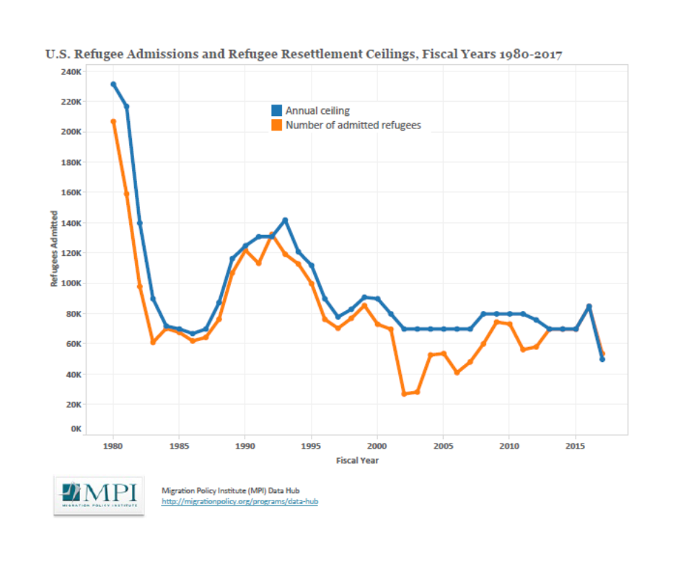
Refugee Caps and Admissions Since 1980
Current numbers do not necessarily reflect need or demand
Higher numbers post-Vietnam and post Cold War

Slide 43
Perspectives on Refugees
Big surges after end of Vietnam war and at end of cold war
Fairly steady at 60,000-80,000 recently … despite increased need
Trump administration looking to limit further
80,000 represents less than 0.02% of US population
Compare Canada:
  40,000 refugees admitted in 2016, which is about 0.11% of its population
  But US has many more who become LPR via asylum

Slide 44
How people become new LPRs
Main categories:
  805,000 family sponsored in different categories
  50,000 via diversity visa lottery
  158,000 refugees and asylee adjustments
  138,000 employment/ ”merit”?
Each of these categories is in the news!

Slide 45
Current employment based immigration
Administration frequently speaks of “merit-based” systems
US currently has H-1B visa program for higher skilled employees
  Limited to 65,000 new visas per year
Other less used visas for doctors, and other highly skilled people
These visas can lead to green cards over time
  But not the seasonal H2-B seasonal workers used at Mar-a-Lago
US government is making life more difficult for H-1B visa applicants and holders
  Closer scrutiny
  Harder to re-apply
  Removing ability for spouses to work
  Seems contrary to Trump Administration statements about wanting “merit”

Slide 46
In the News: “Merit Based” immigration
General idea is to credit people for certain attributes, like education, English-proficiency, skills, job offers, etc.
Could change composition of immigrants; effect on numbers? Could:
  Increase immigration: add more “merit”-based immigrants to the mix
  Offset: other forms of immigration could be reduced to offset
  Decrease: “merit” added, while other forms are cut more
Republican RAISE ACT adds no “merit-based” programs
Trump administration says it wants more “merit” but has proposed nothing to expand or simplify this path

Slide 47
Canada’s Point System
Canada has a points system, with points for:
  Education
  Job offers
  Age (more if you are in your 20s; none over 45)
  Language skills (English or French)
  But also points for having a relative in Canada
    So Canada does give credit for having family in country
You need a minimum # of points to qualify
Individual states can increase immigration for local needs
Point system is in addition to family sponsorship, refugees, etc

Slide 48
New Immigrants: Compare to Canada
As % of population, Canada admits:
10x number of economic
similar number of family members (but mostly from economic immigrants)
2.5x number of refugees/asylees

Slide 49
Other topics
Temporary Protective Status
Deferred Action for Childhood Arrivals (DACA)
Unaccompanied Alien Children (UACs)
Visa Waiver Program

Slide 50
In the News: Temporary Protective Status (TPS)
Law provides that President can declare that people here from certain countries do not have to go back, usually because of war or natural disaster
  Applies whether you are here lawfully or not, but had to be here on a certain date
  Allows work authorization ($495 fee)
  Allows for travel with “advance parole” ($575 fee)
  No deportation, but no path to green card/citizenship from TPS
    Although people can get in a different path through other means (marriage, family sponsorship)
  Usually applies for 18 months at a time; government often renews
TPS is being discontinued in 2018 or 2019 in El Salvador, Haiti, Nicaragua, Sudan (and probably Honduras in 2019?)
Countries with TPS: Nepal, Somalia, South Sudan, Syria, Yemen

Slide 51
In the News: Temporary Protective Status (TPS)
Haiti: TPS extended one final time to July 2019
  After that, people will return to Haiti, or remain undocumented
  Estimated 50-60,000 people
  Boston area is believed to be the 3rd largest community (after NYC and Miami)
Argument against continuing TPS:
  Haitians have had TPS since 2010, and El Salvador, Honduras, Nicaragua since 1999/2000 timeframe
  “Temporary” does not mean forever
Problem for Haitians
  Country is still desperately poor
  Significant funds to Haitians come from remittances from Haitians in the US

Slide 52
Other topics
Temporary Protective Status
Deferred Action for Childhood Arrivals (DACA)
Unaccompanied Alien Children (UACs)
Visa Waiver Program

Slide 53
DACA
Obama established DACA by executive order in 2012
A policy of deportation/enforcement priority
  15m LPRs and 12m undocumented people, but only resources for a few 100,000s deportations per year
  Idea was to go after criminals first – with or without lawful status
DACA applies to undocumented people; requirements:
  Under age of 31 as of June 15, 2012
  Entered the United States prior to 16th birthday
  Resided in the United States since June 15, 2007
  Education and/or military requirements
  No serious criminal convictions

Slide 54
DACA
Idea: people who are brought to the US as children are innocent
  Parents are the wrongdoers (entered illegally, or overstayed visas)
  Many children have lived here for years, and are fully assimilated
    Some do not even know they are not documented until they are much older
DACA allows work authorization, SS card, and drivers license
No guarantees of extension
Similar in effect to TPS, but DACA not expressly authorized by statute
Statute does give discretion for prioritizing deportations
Est. 1.8m theoretical beneficiaries; about 700,000 have DACA status
  80% of DACA recipients are from Mexico; rest from about 14 countries

Slide 55
In the News: DACA and “Path to Citizenship”
There is no such thing as a direct grant of citizenship
Path starts with LPR status
  Then, LPR can apply for citizenship (usually 5+ years)
As used in the DACA debate:
  “Path to citizenship” means the ability to get LPR status, and from that, to later be able to apply for citizenship
  Some have proposed a permanent non-LPR status or a second-class LPR status that cannot turn to citizenship (which would not allow them to vote), or would have a longer wait
  Some proposals would forbid citizens who got LPR from petitioning for parents to get green cards
    Consistent with the idea that the parents are the wrongdoers

Slide 56
In the News: “Path to Citizenship”
Why don’t undocumented people just “get in line like everyone else”?
  E.g., statement of Republican congressman on Fox & Friends, January 2018
For most there is no line to get in
  Need to get LPR status first, which requires:
    Family connection
    Employment path (limited)
    Win visa lottery (long shot) and most countries with DACA kids would not participate
  You can’t just sponsor your friend, or nanny, or aunt/uncle

Slide 57
Other topics
Temporary Protective Status
Deferred Action for Childhood Arrivals (DACA)
Unaccompanied Alien Children (UACs)
Visa Waiver Program
  Really, a much different topic, but it has the word visa in it

Slide 58
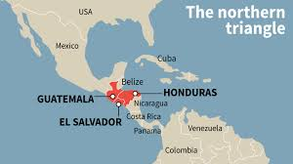
Unaccompanied Alien Children (UACs)
Under 18, with no US-based parent
Mostly from “Northern Triangle”
  Guatemala, Honduras, El Salvador
Fleeing gangs and violence
  “Push” factors, not “pull”
  Exodus from 3 countries, to multiple other countries (not just US)
2013: 38,000; 2014: 68,000; 2015: 38,000; 2016: 58,000; 2017: 41,000
Arrive at the US border looking for asylum
  Cases heard in immigration court
  Child is usually placed with a friend or relative while case is adjudicated

Slide 59
In the News: Minors And Gangs
Trump administration highlighting violent murders by Central Am. gangs, esp. by MS-13, and esp. a double homicide on Long Island
Some facts about MS-13
  Started in Los Angeles; sent to El Salvador through deportations
  10,000 of 1.4m gang members nationwide
  Many members caught in sweeps are US citizens
    See http://www.cnn.com/2017/05/11/politics/ice-gang-arrests-operation/index.html
  More of a street gang than into international smuggling and controlling police and politicians (like Sinaloa or Los Zetas gangs in Mexico)
Why highlight MS-13?
  Brutally violent when they kill – mostly other El Salvadorans
  Historically, many members have had elaborate face tattoos

Slide 60
In the News: Minors And Gangs
SOTU 2018: “Tonight, I am calling on the Congress to finally close the deadly loopholes that have allowed MS-13 and other criminal gangs to break into our country”
  Implications:
  Violent young gang members are infiltrating the US
  “Loopholes” suggests unintended consequences or measures used to evade the law
  Reality:
  Small percent of young people are recruited in the US
    CBP says 159 children apprehended since 2012 suspected of gang membership: 0.07% (159 ÷ 45000 per year over 5 years)
  Law was passed to treat children differently in 2008
    But did not anticipate the volume of kids

Slide 61
Procedure for UACs
Trump admin document: "Loopholes in current law prevent ‘Unaccompanied Alien Children’ (UACs) that arrive in the country illegally from being removed."
Politifact: Mostly False – intentional humanitarian policy choices made in a 2008 law passed by unanimous consent
UACs handled by HHS rather than CBP
Placed with family or friends “in the best interests of the child”
Access to legal assistance
Administration wants to
  Classify fewer as UACs
  End UAC status when they turn 18 even if a case is pending
  Harsher punishment for relatives who assist them getting here

Slide 62
Other topics
Temporary Protective Status
Deferred Action for Childhood Arrivals (DACA)
Unaccompanied Alien Children (UACs)
Visa Waiver Program
  Really, a much different topic, but it has the word visa in it

Slide 63
Visitor Visas
Visas for business or tourism
  About 46m people entered US as a visitor in 2016
Some countries require:
  Get a visa in advance; e.g., Brazil, China, Russia, India, Vietnam, and most countries in Africa
    It can be complicated, or just a matter of filing online and paying a small fee ($20 for Turkey)
  Automatic visa when you arrive
    E.g., Dominican Rep collects $10 each as you enter the terminal and before passport check
  No visa needed
    Canada, Mexico, most of Europe, and various countries in South America, Africa, Asia

Slide 64
In the News: Visa Waiver program
Bilateral agreements with about 38 countries
  No visa needed
  Can stay 90 days
  Works the same both ways
  About 20m visitors to US
Why controversial?
  No vetting of visitors
    Concerns about Islamists from the Netherlands, France, etc.
  Concern about people overstaying visa time
    But estimates are that only 30% of overstays are from visa waiver countries

Slide 65
Sources of Information
Source of most US numbers in this presentation (or derived from there):
  “Yearbook of Immigration Statistics” published by DHS
Legal advice?: get a lawyer!
Free legal consultation: Irish International Immigrant Center, free clinics, about every 2 weeks – www.iiic.org
  Staffed by local volunteer immigration lawyers
The legal foundation: 8 USC § 1101
  Also referred to as INA – Immigration and Naturalization Act
  Rules: Title 8 of the Code of Federal Regulations

Slide 66
END

